Slide 1
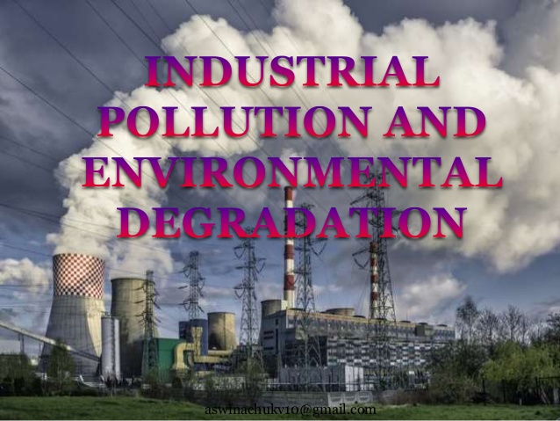

Slide 2
Industrial Pollution and Environmental Degradation
Types of Pollution
Water
Noise
Air
Land
Thermal

Slide 3
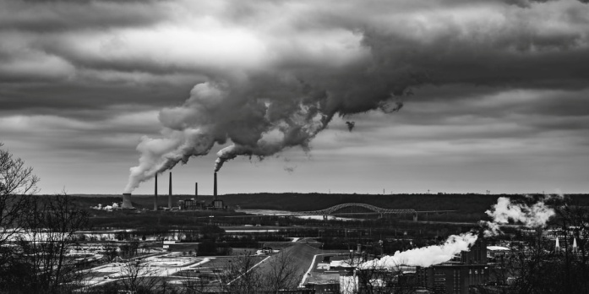
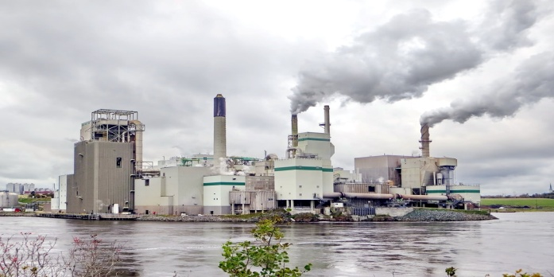
Air Pollution
Smoke emitted by chemical and paper factories, brick kilns, refineries and smelting plants, and burning of fossil fuels in factories that ignore pollution norms.
Air-borne particulate materials contain both solid and liquid particles like dust, sprays, mist and smoke.

Slide 4
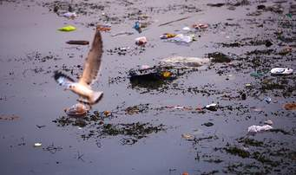
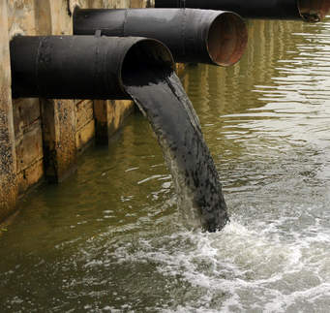
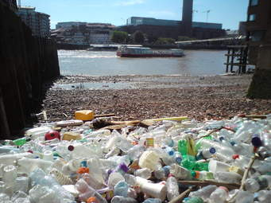
Water pollution
Major water pollutants are dyes, detergents, acids and salts.
Heavy metals like lead and mercury, pesticides and fertilizers and synthetic chemicals with carbon, plastics and rubber, etc. discharged into the water bodies without treatment pollute these water bodies.

Slide 5
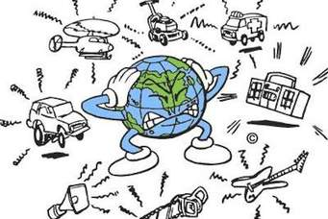
Noise pollution
The generators, compressors, machines, furnaces, looms, exhaust fans, etc. used by industries create a lot of noise.
Noise can raise blood pressure and can have physiological effects as well.

Slide 6
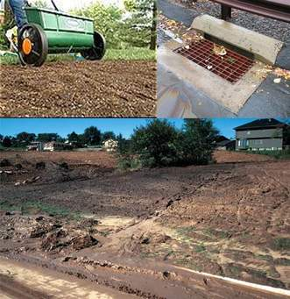
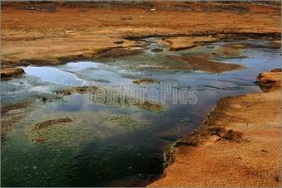
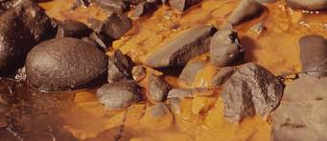
Land pollution
Land and water pollution are closely related.
Dumping of industrial wastes especially glass, harmful chemicals, industrial effluents, packing, salts and garbage into the soil.

Slide 7
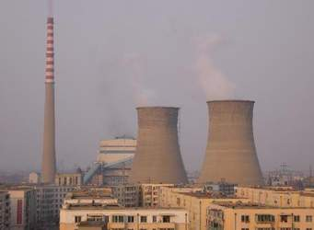
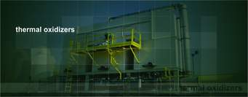
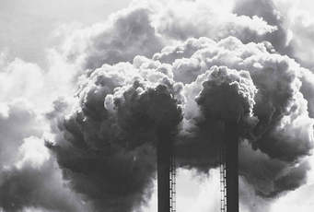
Thermal pollution
Wastes from nuclear power plants, nuclear and weapon production facilities cause cancer and birth defects.

Slide 8
Measures to Control Air Pollution
Particulate matter in the air can be reduced by fitting smoke stacks to factories with fabric filters, electrostatic precipitators etc.
Equipment’s to control aerosol emissions can be used in industries, e.g., electrostatic precipitators, scrubbers and inertial separators.
Smoke can be reduced by using oil or gas instead of coal in factories.

Slide 9
Measures to Control Water Pollution
Minimizing the use of water for processing by reusing and recycling.
Harvesting of rain-water to meet water requirements of industries and other domestic purposes.
Treating hot water and effluents before releasing them into rivers and ponds in the following ways:
Primary treatment by mechanical means such as screening, grinding, flocculation and sedimentation. Secondary treatment by biological process.
Tertiary treatment by biological, chemical and physical processes. This involves recycling of waste water.

Slide 10
Steps to minimize the environmental degradation caused by industrial development
Minimizing the use of water for processing by reusing and recycling in two or more successive stages.
Harvesting of rain water to meet domestic and industrial water requirements.
Treating hot water and effluents before releasing them into rivers and ponds.
Particulate matter in the air can be reduced by fitting smoke to factories with electrostatic precipitators, fabric filters, scrubbers and inertial separators. Smoke can be reduced by using oil or gas instead of coal in factories.
Machinery and equipments can be fitted with silencers to prevent noise pollution.

Slide 12
Pro-active approach adopted by the National Thermal Power Corporation (NTPC) for preserving the natural environment and resources
Optimum utilization and up-gradation of equipment by adopting latest techniques.
Minimizing waste generation by maximising ash utilization.
Providing green belts for nurturing ecological balance.
Reducing environmental pollution through ash pond management, ash water recycling system and liquid waste management.
Ecological monitoring, reviews and online data base management for all its power stations.

Slide 13
Nancy George
AECS Mysore

